Slide 1

Statistical Analysis of Credit Card Customer Churn Rate
Abhishek Kumar
Alekhya V
Santhosh M M
Sushma D
Team 8

Slide 2
Agenda:
Introduction to Dataset
Descriptive Statistics
Analysis of Customer Churn rate using statistical testing methods
Conclusion
Simulation

Slide 3

Business manager of a consumer credit card portfolio of a bank is facing severe customer attrition problem in the recent months. This is impacting the business. The business manager wants to leverage the power of data analytics to understand the primary reasons of attrition.
Problem Statement

Slide 4
What is our current customer churn rate?
Problem Statement
What are the main causes of customer churn?
Which specific customers are at risk for churning?

Slide 5
Introduction to the dataset
This dataset consists of 10,127 customers mentioning their age, salary, marital_status, credit card limit, credit card category, etc.
Total Features = 21
Categorical features – 6
Continuous features – 15
Categorical Data: Attrition_Flag, Gender, Education_Level, Marital_Status, Income_Category, Card_Category
Numerical Data: Clientnum, Customer_Age, Dependent_count, Months_on_book, Total_Relationship_Count, Months_Inactive_12_mon, Contacts_Count_12_mon, Credit_Limit , Total_Revolving_Bal, Avg_Open_To_Buy, Total_Amt_Chng_Q4_Q1, Total_Trans_Amt, Total_Trans_Ct, Total_Ct_Chng_Q4_Q1, Avg_Utilization_Ratio

Slide 6
CLIENTNUM: Client number. Unique identifier for the customer holding the account
Attrition_Flag: Internal event (customer activity) variable - if the account is closed then 1 else 0
Customer_Age: Demographic variable - Customer's Age in Years
Gender : M=Male, F=Female
Dependent_count: Number of dependents
Education_Level: Educational Qualification of the account holder (example: high school, college graduate, etc.)
Marital_Status: Married, Single, Divorced, Unknown
Income_Category: Annual Income Category of the account holder (< 40𝐾, 40K - 60K, 60𝐾− 80K, 80𝐾− 120K)
Card_Category : Type of Card (Blue, Silver, Gold, Platinum)
Months_on_book: Period of relationship with bank
Total_Relationship_Count : Total no. of products held by the customer
Months_Inactive_12_mon : No. of months inactive in the last 12 months
Contacts_Count_12_mon : No. of Contacts in the last 12 months
Credit_Limit : Credit Limit on the Credit Card
Total_Revolving_Bal : Total Revolving Balance on the Credit Card
Avg_Open_To_Buy : Open to Buy Credit Line (Average of last 12 months)
Total_Amt_Chng_Q4_Q1 : Change in Transaction Amount (Q4 over Q1)
Total_Trans_Amt :Total Transaction Amount (Last 12 months)
Total_Trans_Ct : Total Transaction Count (Last 12 months)
Total_Ct_Chng_Q4_Q1 : Change in Transaction Count (Q4 over Q1)
Avg_Utilization_Ratio : Average Card Utilization Ratio

Slide 7
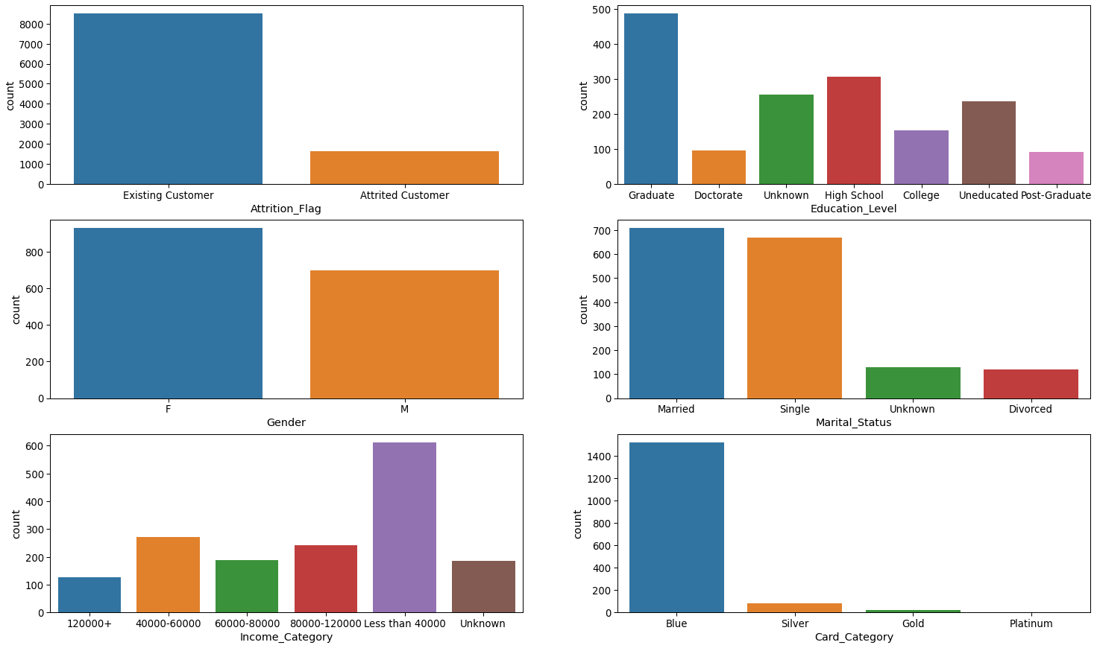
Distribution of Categorical Features

Slide 8
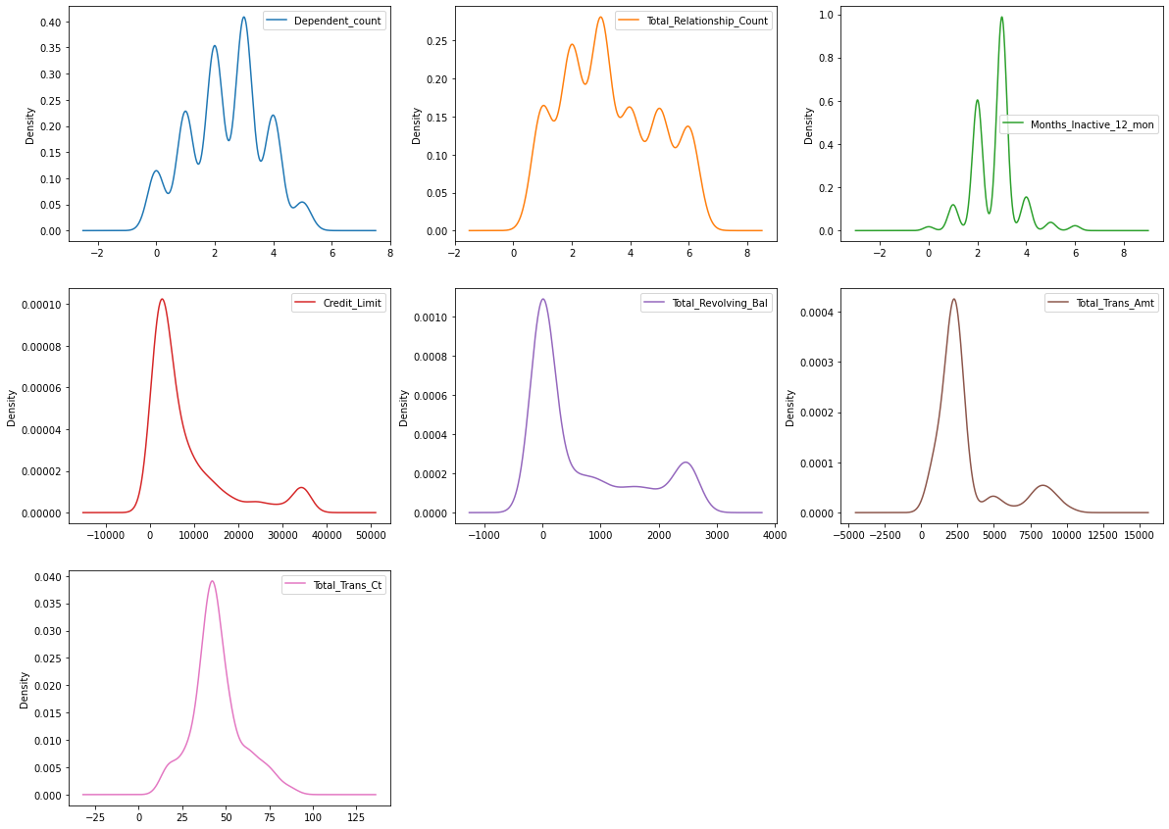
Distribution of Numerical features

Slide 9
What are the main factors influencing customer churn?
Which income group is contributing more towards the churn rate
Is marital status influencing the use of credit card
Credit card limit of high churn rate
Age group contributing to more churn count
Compare total Revolving balances of Existing and Attrited customers
What effects does Gender and Educational background has towards the churn rate

Slide 10
Manager has few claims and queries based on his experience
Manager believes there is an equal chance of Attrition for all Income groups
Manager wishes to know if the average use of credit card is same among all Marital Status categories
Manager wants to check if the people with credit limit less than 10000 are having high churn rate
Manager believes Customer Age and Marital Status columns are dependent and any one of the variable can be considered to address the churn analysis
Total Revolving balance of both Attrited and Existing customers are equal
What effects does Gender and Educational background has towards the churn rate

Slide 11
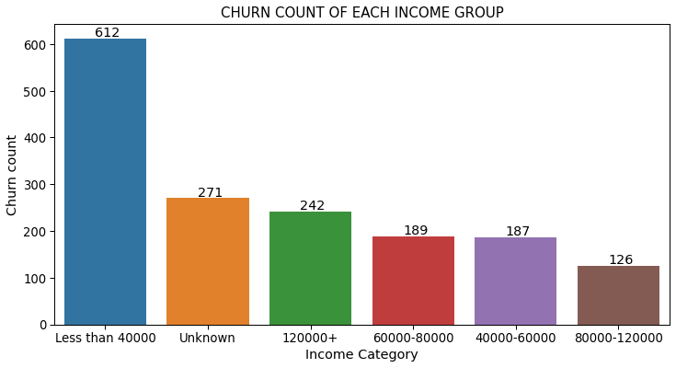
Manager believes there is an equal chance of Attrition for all Income groups
CHI SQUARE GOODNESS OF FIT TEST
Null hypothesis : All the Income categories have equal Attrition rate
Alternate hypothesis: All the Income categories doesn't have equal Attrition rate
Chi square test statistic is 560.27
p value is 7.734398388060016e-119
Since p value is less 0.05, we reject the Null Hypothesis
Interpretation:
the Manager claim is not true and attrition rate varies with the income groups

Slide 12
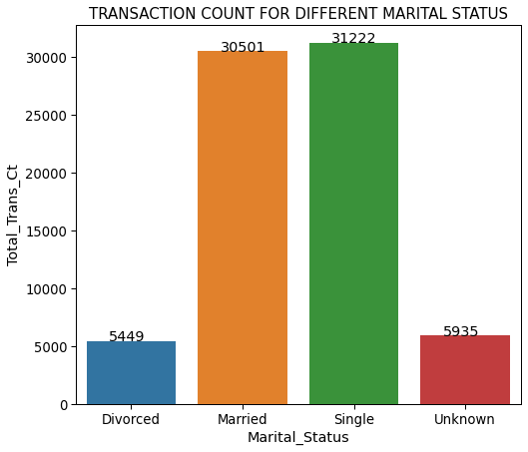
Manager wishes to know if the average use of credit card is same among all Marital Status categories
KRUSKAL - WALLIS H TEST
Null hypothesis : Credit card usage is the same among all Marital categories
Alternate hypothesis: Credit card usage is the not same among all Marital categories
F test Statistic is 24.28
p value 2.1759994712835256e-05
Since F test statistic is greater than critical value(7.814) and p value is less than 0.05, we reject the Null Hypothesis
Interpretation:
average use of credit card is not same among all Marital categories

Slide 13
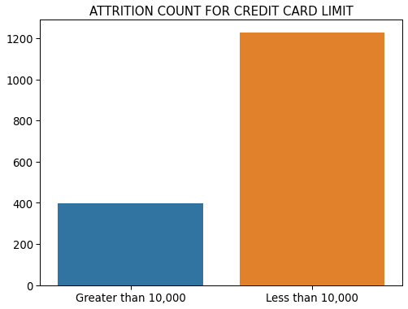
Manager wants to check if the people with credit limit less than 10000 are having high churn rate
WILCOXON SIGNED RANK TEST
Null hypothesis : Average credit limit of people churning is less than or equal to 10000
Alternate hypothesis: Average credit limit of people churning is more than 10000
p value is 0.99989358
Since p value is greater than 0.05, we fail to reject the Null Hypothesis
Interpretation:
the Manager claim is true and customers having credit limit less than 10,000 are having high churn rate

Slide 14
Manager believes Customer Age and Marital Status columns are dependent and any one of the variable can be considered to address the churn analysis
CHI SQUARE TEST OF INDEPENDENCE
Null hypothesis : Customer Age and Marital Status are independent
Alternate hypothesis: Customer Age and Marital Status are dependent
Statistic is 13.52
p value is 0.140
Since test statistic is less than critical value(16.91) and p value is greater than 0.05, we fail reject the Null Hypothesis
Interpretation:
Manager’s claim is not true and Customer Age and Marital Status variables are independent

Slide 15
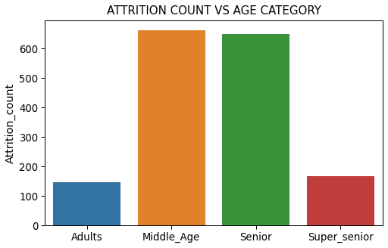
Once we communicated the same to the manager, he was satisfied with the explanation but produced new claim stating senior citizens form the major contributors to churn count
Category | Age group (yrs) | Attrition_count | Contribution
Middle_Age | 36-45 | 664 | 0.408113
Senior | 46-55 | 649 | 0.398894
Super_senior | 56-68 | 168 | 0.103258
Adults | 26-35 | 146 | 0.089736
Customers in the age group between 36 and 45 years tend to have more churn rate followed by the age group between 46 and 55 years, which almost contributes to 40% of the churn rate.
Even though Senior age groups doesn’t top the list, they form the major contributors to churn rate and thus we can agree with the Manager’s claim but with the right picture being displayed

Slide 16
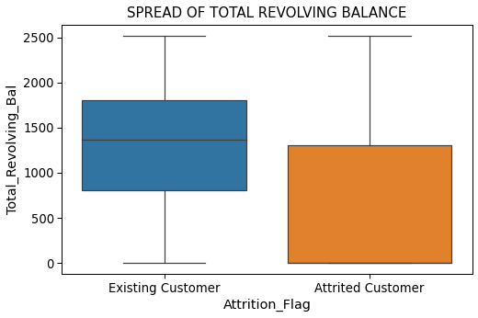
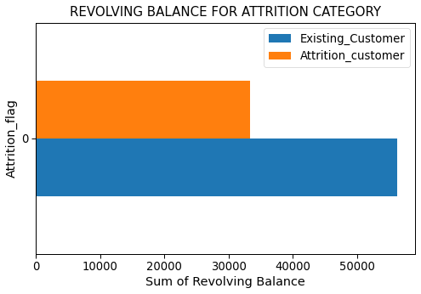

Total Revolving balance of both existing and attrited customers are equal
MANN-WHITNEY U TEST
Null hypothesis : Revolving balance of both Existing and Attrited customers are equal
Alternate hypothesis: Revolving balance of both Existing and Attrited customers are not equal
33365
56237
Interpretation:
Total Revolving balance for Attrited and Existing customers are not the same and clearly there is no effect of Revolving balance on churn rate

Slide 17
Effects of Gender and Educational background on churn rate
CHI SQUARE TEST OF INDEPENDENCE
Null Hypothesis: Gender and Education background are Independent¶
Alternate Hypothesis: Gender and Education background are Dependent
Test statistic is 12.9686
p value is 0.0435
Test statistic is slightly greater than critical value(12.59) and p value is less than 0.05, so we reject the Null Hypothesis
And conclude that both Gender and Educational background are dependent
Let’s also analyze these 2 factors individually.

Slide 18
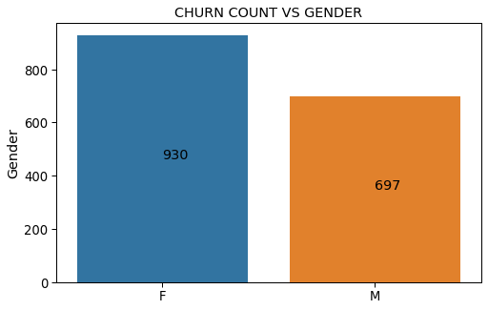
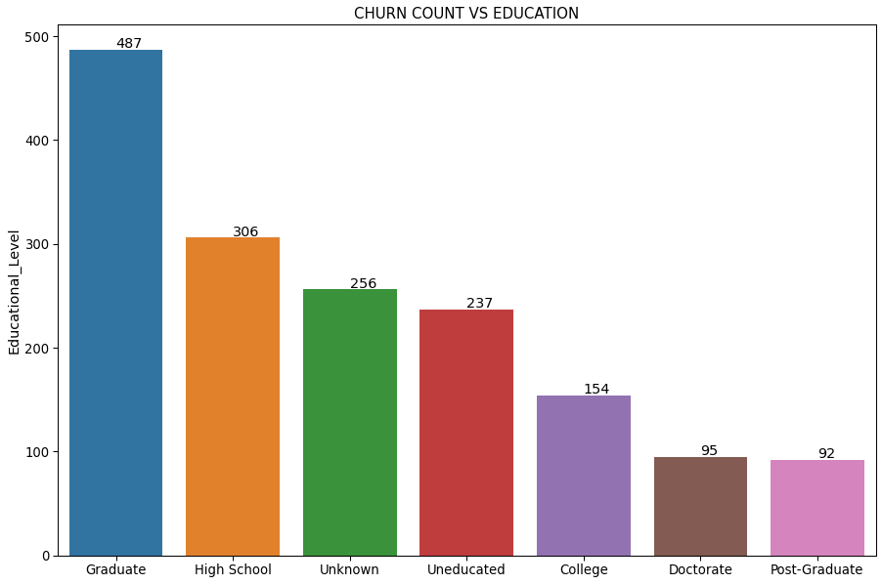
Female customers have more churn rate compared to the male customers
Educational level plays no significant role in churn rate
Customers irrespective of their educational background seem to be churning from the credit card services.
Thus, we can clearly ignore this feature

Slide 19
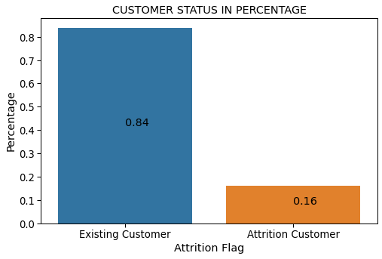
Let’s address the questions now…
1. What is our current customer churn rate?
Existing Customer = 84%
Churned Customers = 16%

Slide 20
2. What are the main factors affecting customer churn?
Credit limit
Income category
Gender
Age
Card category

Slide 21
3. Which specific customers are at risk for churning
Customers having income less than 40,000
Customers offered with credit limit less than 10,000
Customers of age less than 35 or greater than 55
Female customers
Customers belonging to blue card category

Slide 22
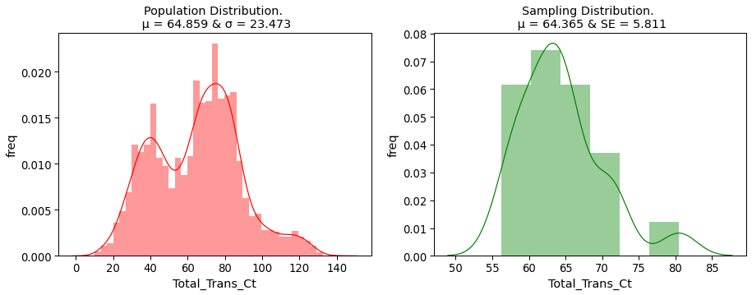
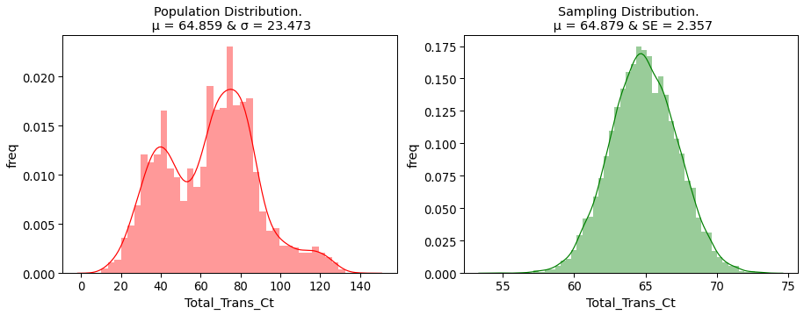
Simulation of Total Transaction count
n_sample = 20
Sample_size = 20
n_sample = 10000
Sample_size = 100

Slide 23
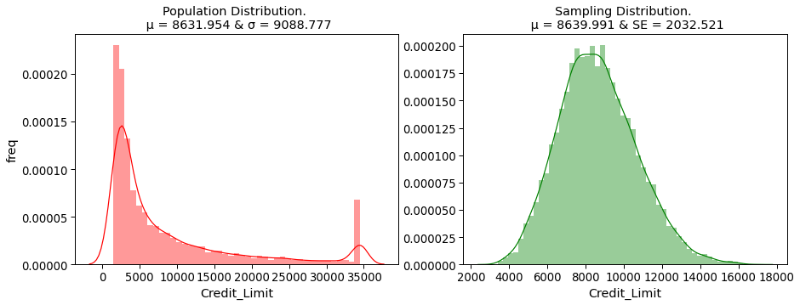
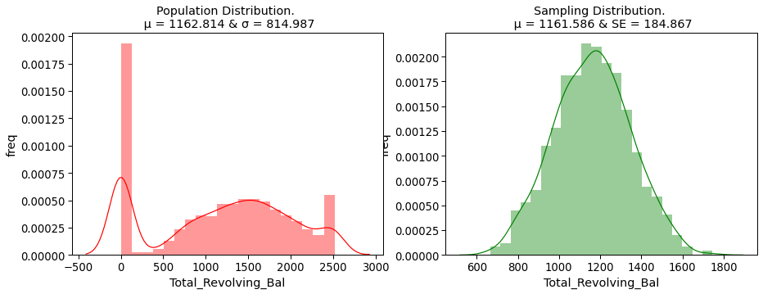
n_sample = 10,000
Sample_size = 20
n_sample = 1000
Sample_size = 20

Slide 24
References
https://drive.google.com/file/d/1EeeokSQSnp_W_R_ZW9qLyVgP6_b7ZSP6/view?usp=sharing
https://leapsapp.analyttica.com/
https://www.itl.nist.gov/div898/handbook/
https://hrcak.srce.hr/103790

Slide 25
Thank you

